Slide 1

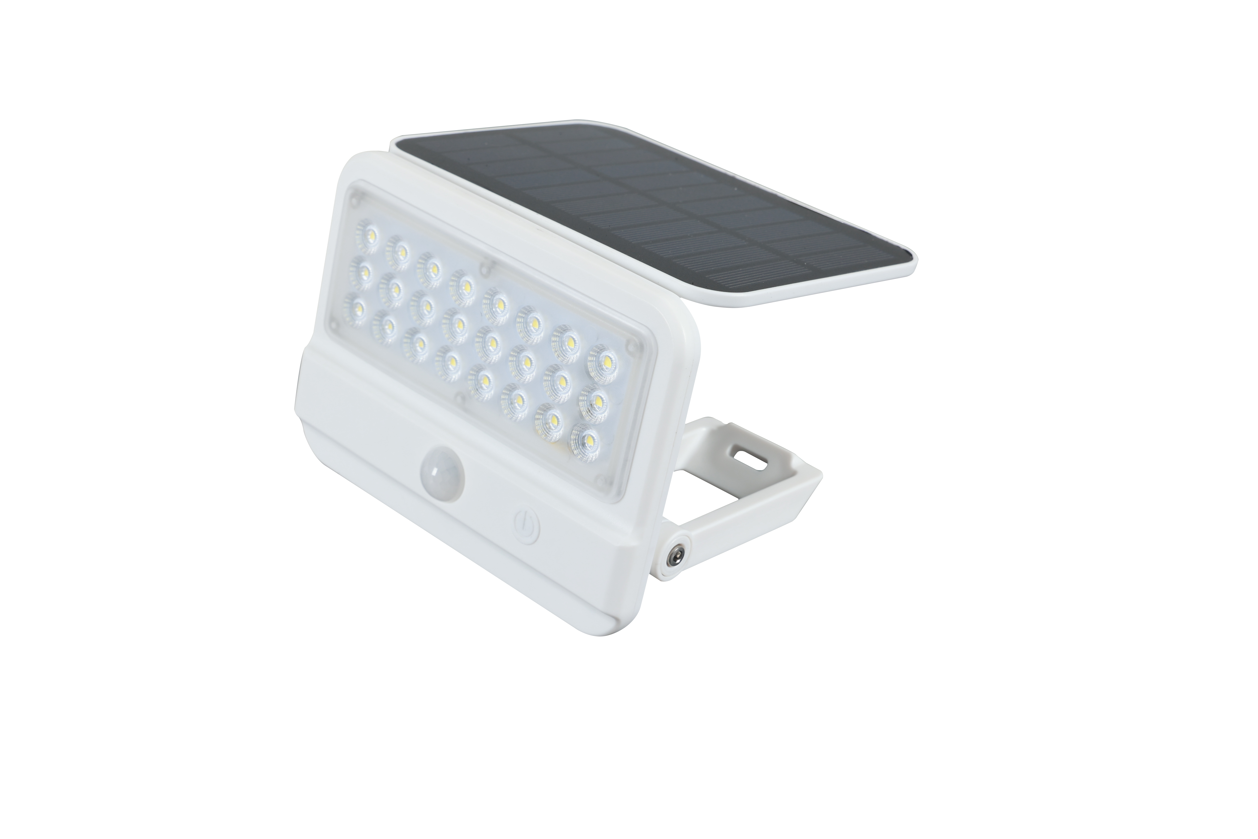
F - LG201
01
Solar integrated floodlight
Provide a new energy portable lighting experience

Slide 2
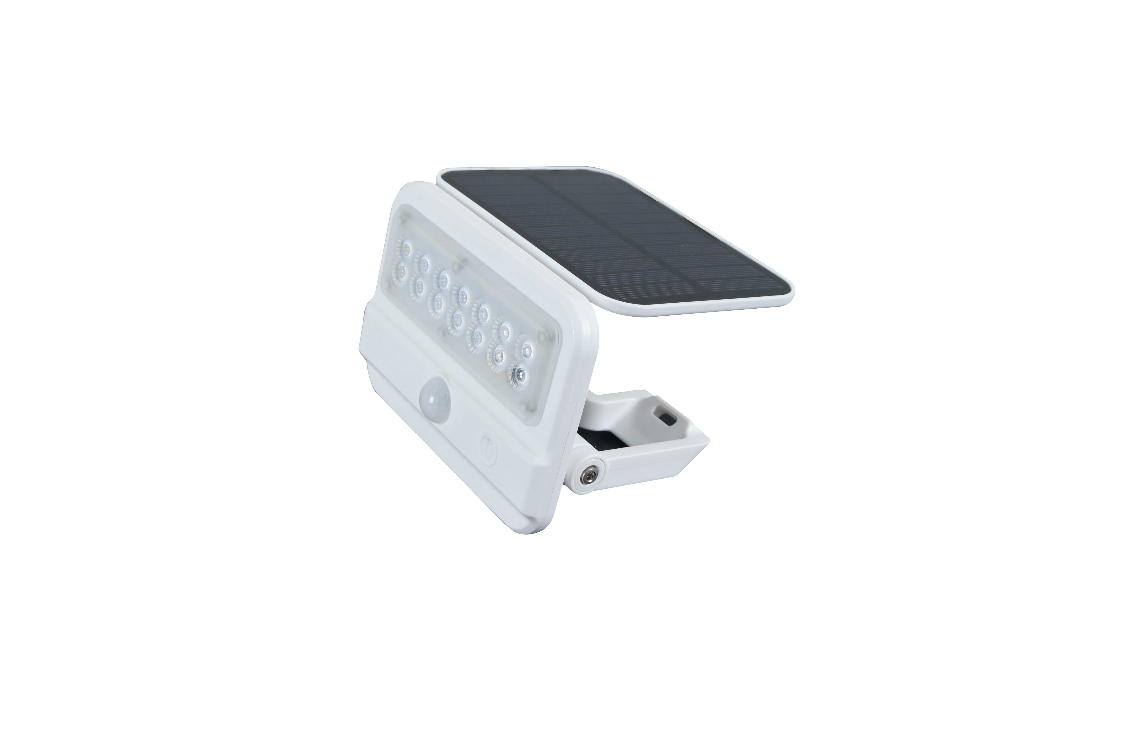
F - LG201
Characteristics
F-LG201-2W (promotional version)
2W
200lm
18650-3.7V 1000mAh
5.5V 1W polycrystalline silicon
Model
Power
Luminous flux
Battery
Solar panel
Model
Power
Luminous flux
Battery
Solar panel
F-LG201-4W (promotional version)
4W
500lm
18650-3.7V 1500MA
5.5V 1.5W polycrystalline silicon
IP level
Material
Functional feature
1st gear
2nd gear
Color:
IP54
PC+ABS
switch shifting
The infrared sensor mode turns on the lights and the lights are fully on. Turn off the lights after the induction lasts for 20s.
The infrared sensor mode is on, the lights are fully bright, and the brightness will be 15% after 20s.

Slide 3
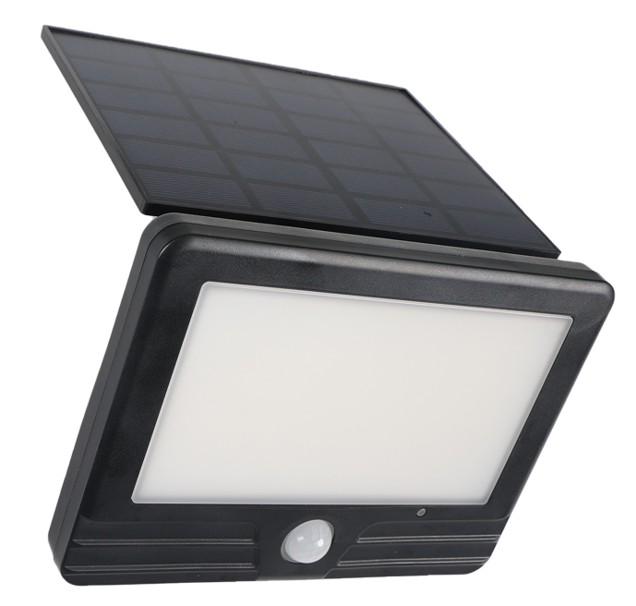
F - LG105
02
Solar Grass Light
Provide full range of ground mounted lighting

Slide 4
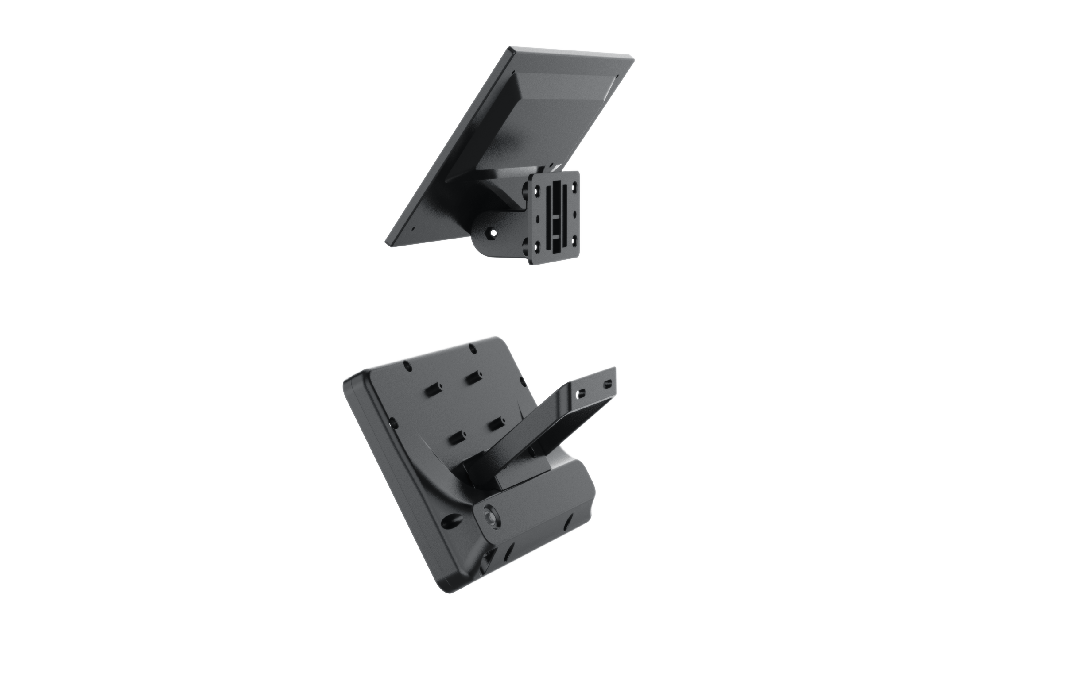
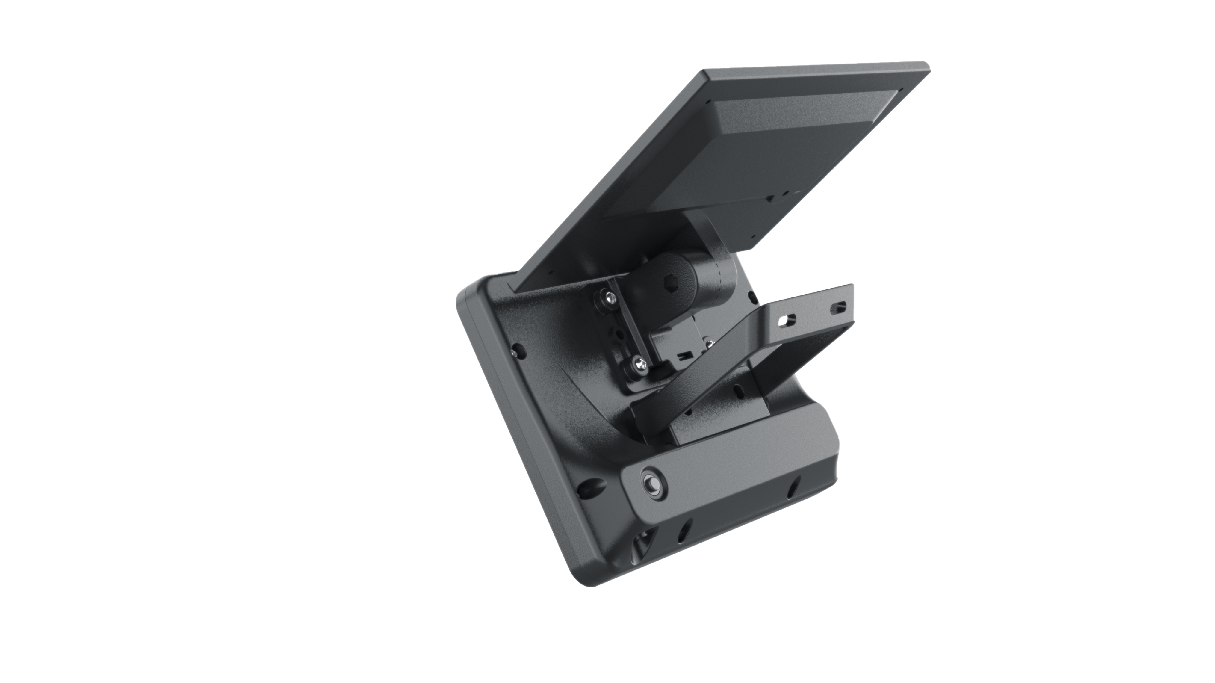
F - LG105
Characteristics
F-LG105-3w-G1
3w
300lm
18650-3.7V 1200mAh
6V 1.2W polycrystalline silicon
Model
Power
Luminous flux
Battery
Solar panel
Model
Power
Luminous flux
Battery
Solar panel
F-LG105-7W-G1
7W
700lm
18650-3.7V 2400MA
6V 2W polycrystalline silicon
IP level
Material
Functional feature
Color
IP54
PC+ABS
Charging time 6-8 hours, automatic sensing at night with continuous light on for 10-12 hours.
Three speed induction mode.

Slide 5
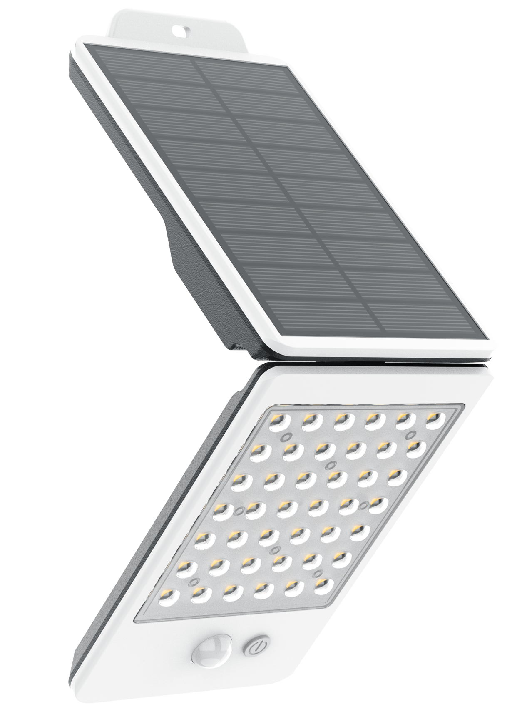
F - WL108
03
Solar foldable wall lamp
Simple foldable induction wall lamp for easy installation

Slide 6
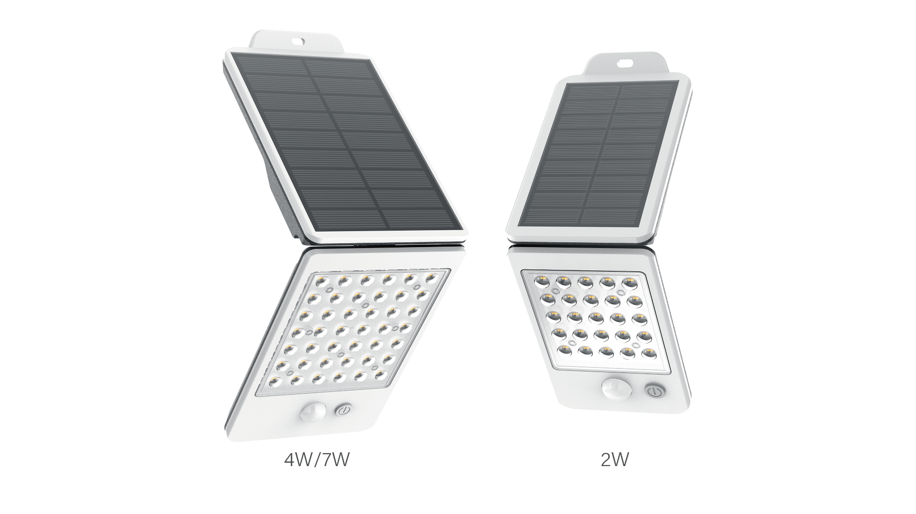
F - WL108
Characteristics
F-WL108-2W (promotional version)
2W
200lm
18650-3.7V 1000mAh
5.5V 1W polycrystalline silicon
Model
Power
Luminous flux
Battery
Solar panel
Model
Power
Luminous flux
Battery
Solar panel
F-WL108-4W (promotional version)
4W
400lm
18650-3.7V 1500MA
5.5V 1.5W polycrystalline silicon
IP level
Material
Functional feature
Color
IP65
PC+ABS
Lights up when someone is detected; After the person leaves, after a delay of 20 seconds, it will become 15% brightness and last for one night.

Slide 7
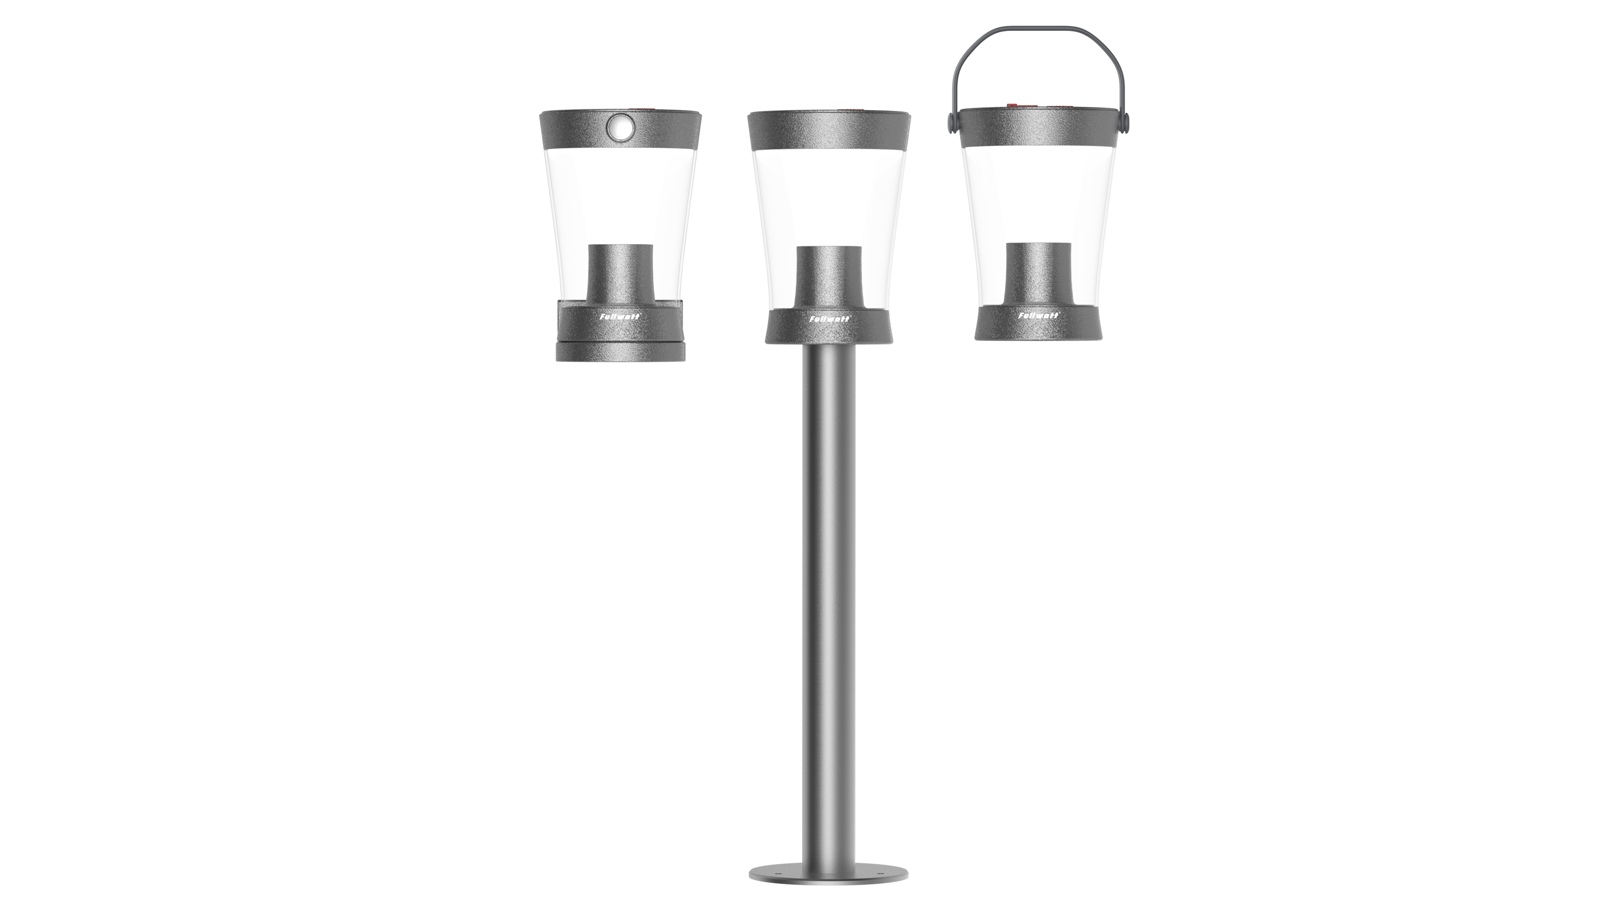
F - WL105 / GL105 / LG305
05
High quality solar wall lamp
Provide integrated solar panels and light sources for enhanced overall feel

Slide 8
F - GL105
Characteristics
Model
Power
Luminous flux
Battery
Solar panel
F - GL105 3W
3W
450lm
3.7V-2000mAh
5.5V-1.5W Monocrystalline silicon
IP level
Material
Functional feature
charging time
Working time
Color
IP65
PC+ABS
First gear, turn on the light at 50% brightness for 1 hour, then decrease the brightness to 20% for 5 hours, and then decrease the brightness to 5% until dawn.
Second gear, 100% brightness in the first minute, 75% brightness in 1-10 minutes, 50% brightness in 10-30 minutes, 20% brightness in half an hour -5 hours, and 5% brightness in 5-10 hours
6-8 h
10-12h

Slide 9
F - WL105
Characteristics
Model
Power
Luminous flux
Battery
Solar panel
F - WL105 3W
3W
450lm
3.7V-2000mAh
5.5V-1.5W Monocrystalline silicon
IP level
Material
Functional feature
charging time
Working time
Color
IP54
PC+ABS
1st gear: In infrared sensing mode, all lights are turned on, and the sensing is maintained for 20 seconds. After the person leaves, the lights are turned off. 2nd gear: In infrared sensing mode, all lights are on, and the brightness is 15% after 20 seconds. 3rd gear: 100% brightness in the 1st minute, 75% brightness in the 1st to 10th minute, 50% brightness in the 10th to 30th minute, 15% brightness in the 5th to 5th hour, and 5% brightness in the 5th to 10th hour
6-8 h
10-12h

Slide 10
F - LG305
Characteristics
Model
Power
Luminous flux
Battery
Solar panel
F - LG305-3W
3W
450lm
3.7V-2000mAh
5.5V-1.5W Monocrystalline silicon
IP level
Material
Functional feature
charging time
Working time
Color
IP54
PC+ABS
1st gear: 100% brightness, 2nd gear: 50% brightness, 3rd gear: 20% brightness, 4th gear RGB.
6-8 h
100%-2h

Slide 11
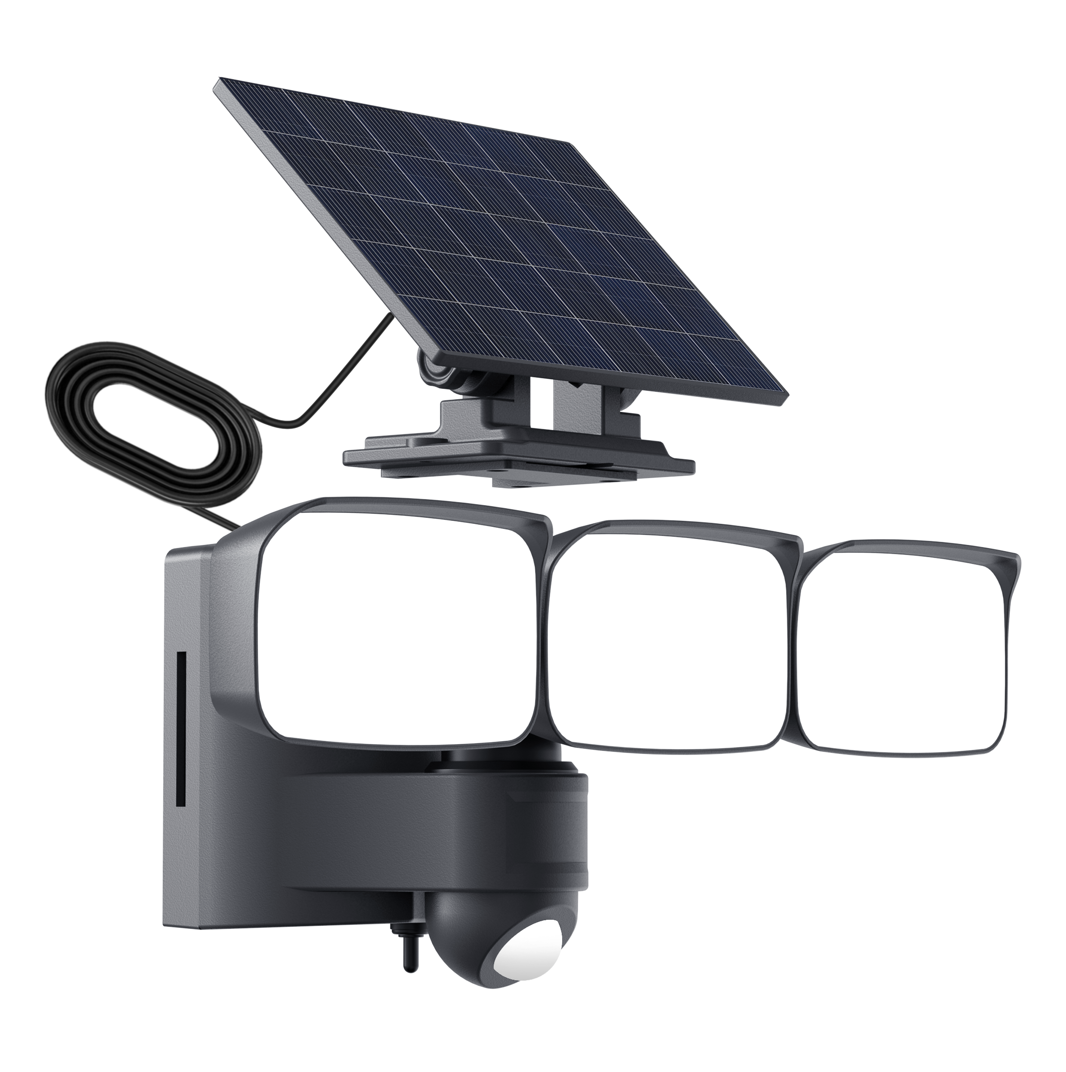
F - WL106
06
Solar five sided wall lamp
Security lights WALL LAMP

Slide 12
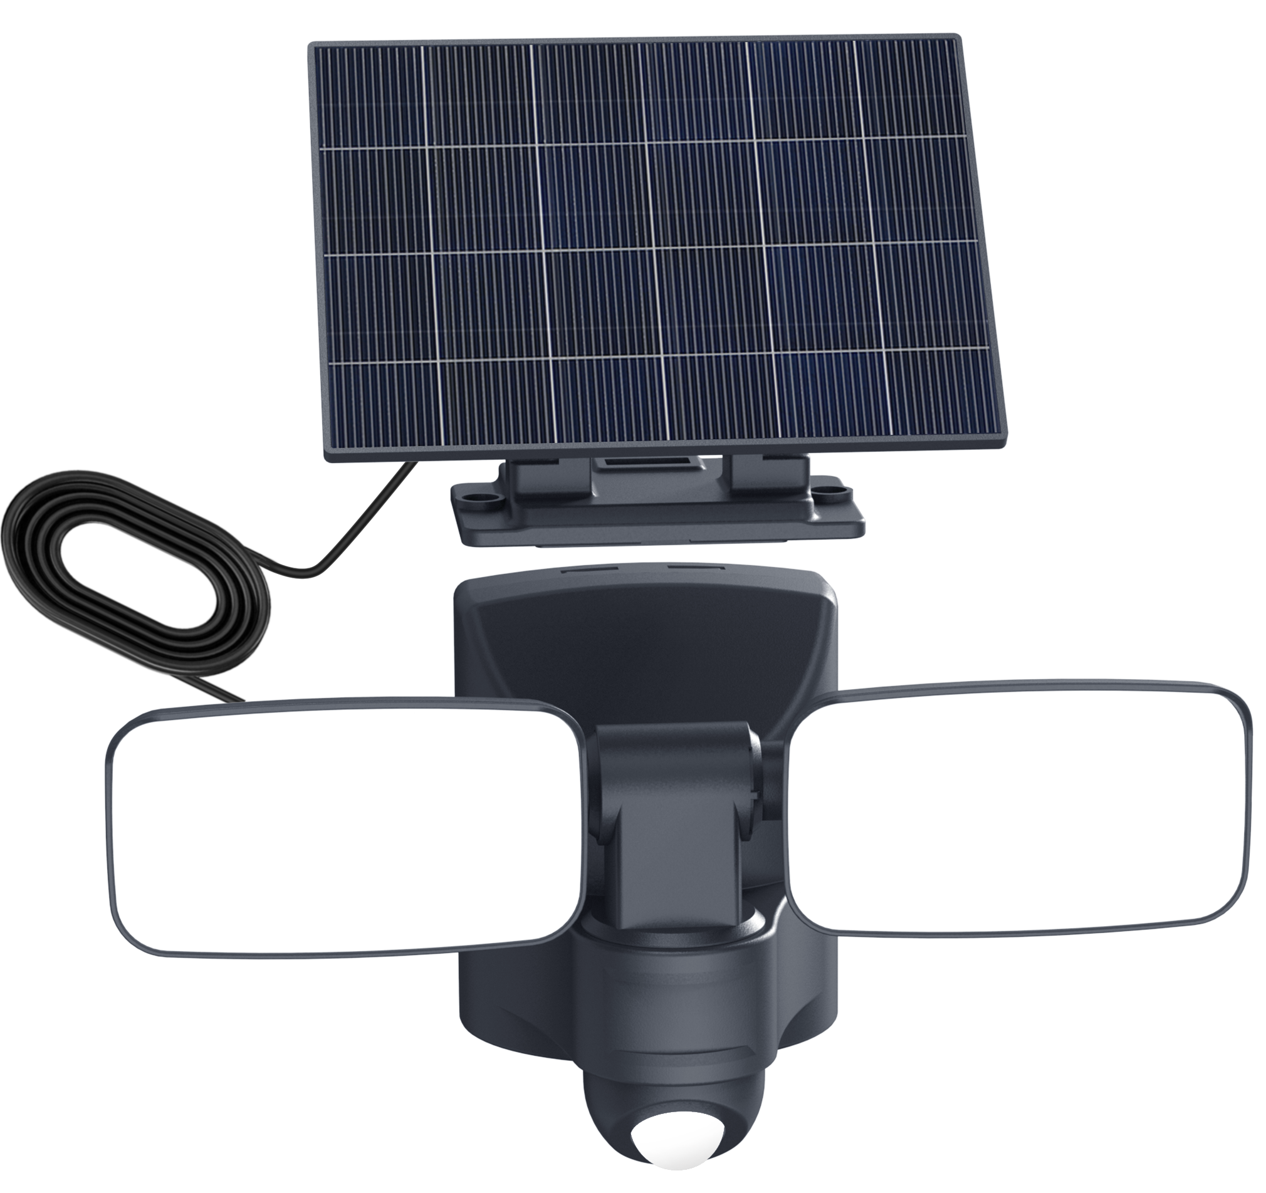
F - WL106
Characteristics
F-WL106-6W
6W
600lm
18650-3.7V 2400mAh
6V 2.4W Monocrystalline silicon
Model
Power
Luminous flux
Battery
Solar panel
Model
Power
Luminous flux
Battery
Solar panel
F-WL106-11W
11W
1100lm
18650-3.7V 4000MA
6V 3W Monocrystalline silicon
IP level
Material
Functional feature
Design Description
Color
IP54
PC+ABS
Induction mode, turn off the light after 20 seconds; 2nd gear sensing mode, 15% slightly lit after 20 seconds.3nd:1 minute 100%,1-10minute 75%,10-30minute 50%,30minute-5hs 15%,5hs-10hs 5%.
product structure in line with current customer aesthetics, split and integrated design, solar panels and lamp bodies can rotate at different angles, not limited by the angle of sunlight.

Slide 13
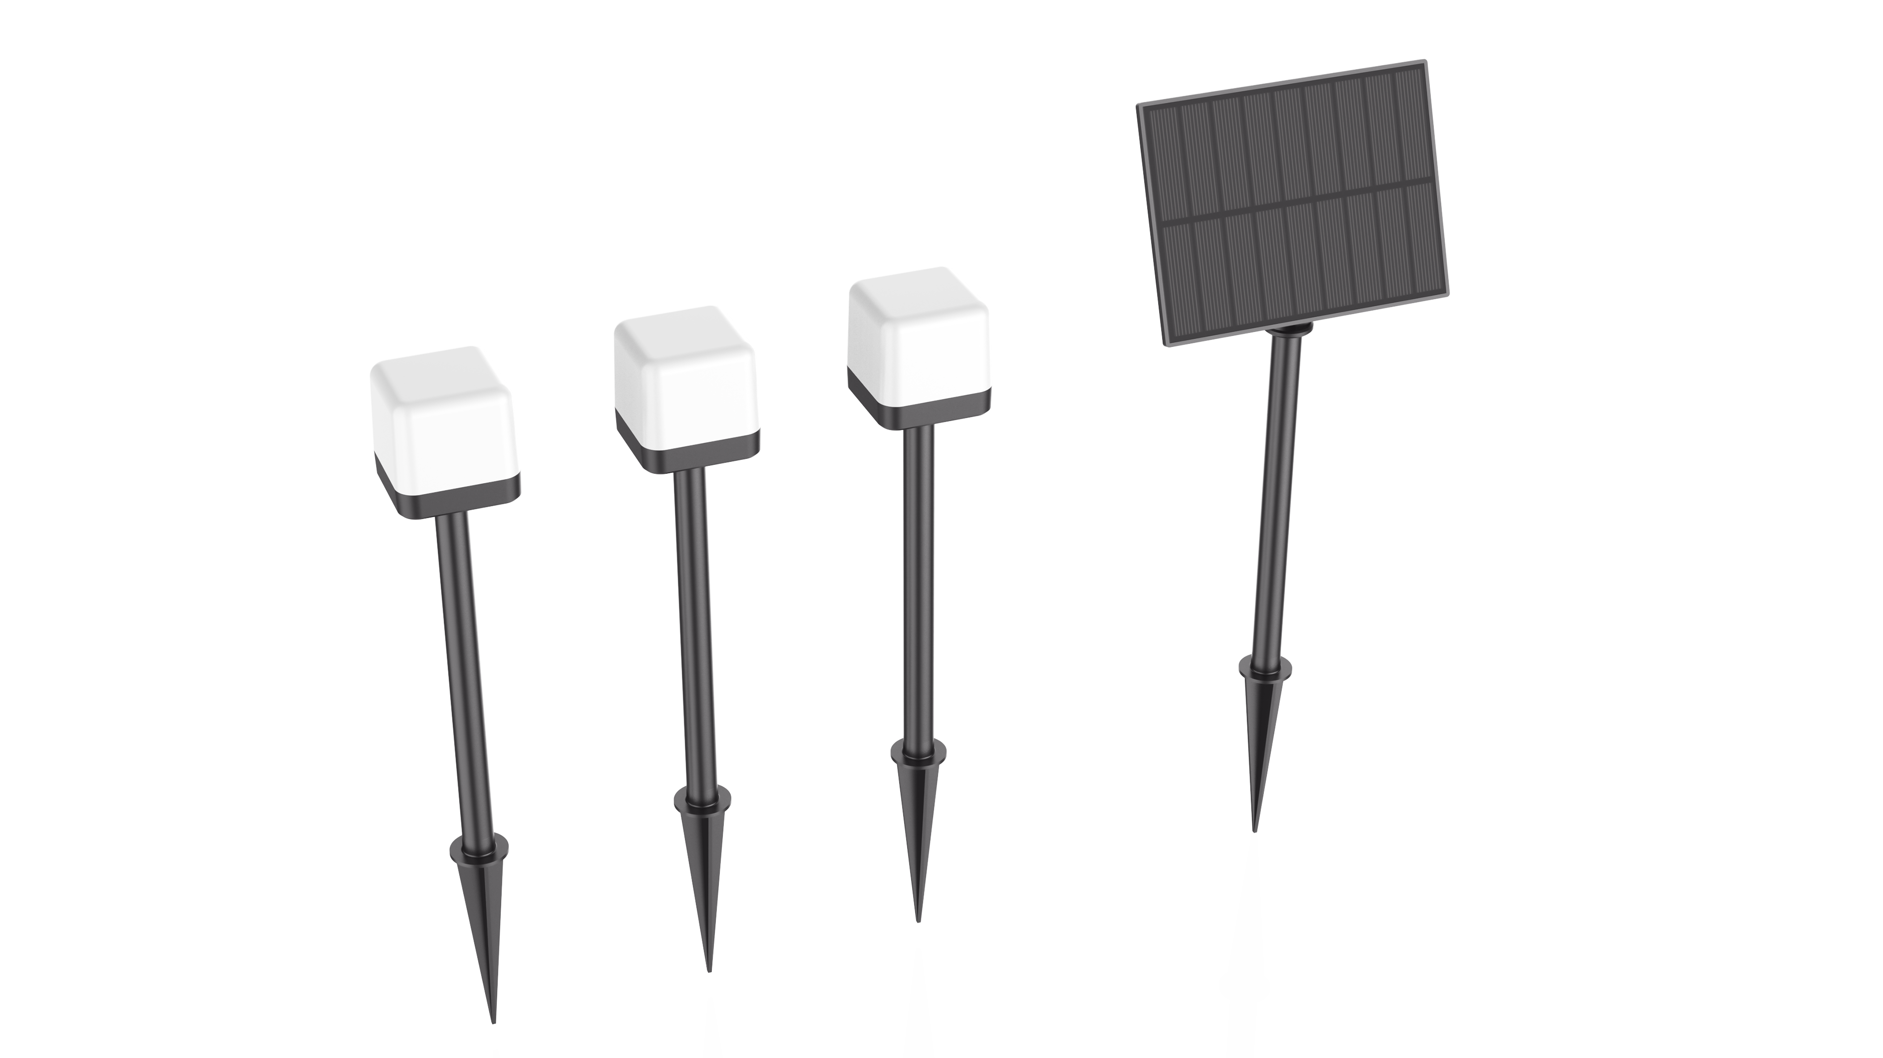
F - GL116
07
Solar Grass Light
Provide full range of ground mounted lighting

Slide 14
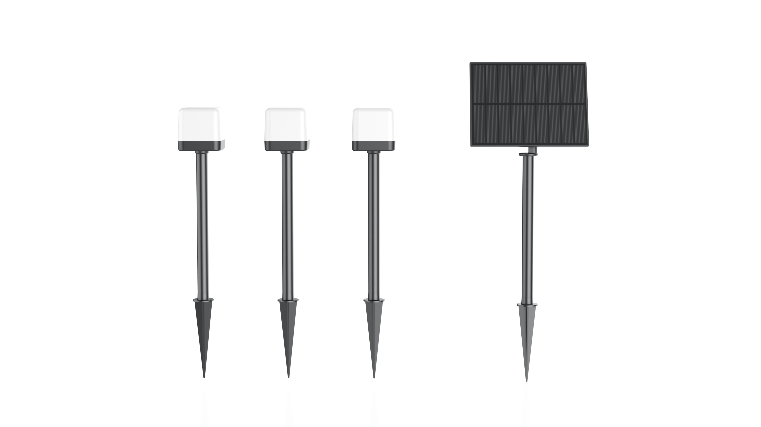
F - GL116
Characteristics
F-GL116-3*0.2W
3*0.2W
3*45lm
18650-3.7V 1500mAh
5.5V 2W polycrystalline silicon
Model
Power
Luminous flux
Battery
Solar panel
Model
Power
Luminous flux
Battery
Solar panel
F-LG201-5*0.2W
5*0.2W
5*45lm
18650-3.7V 2400MA
5.5V 2.5W polycrystalline silicon
IP level
Material
Functional feature
Color
IP65
PC+ABS
Charging time 4-5 hours, automatic sensing at night with continuous light on for 10-12 hours.

Slide 15
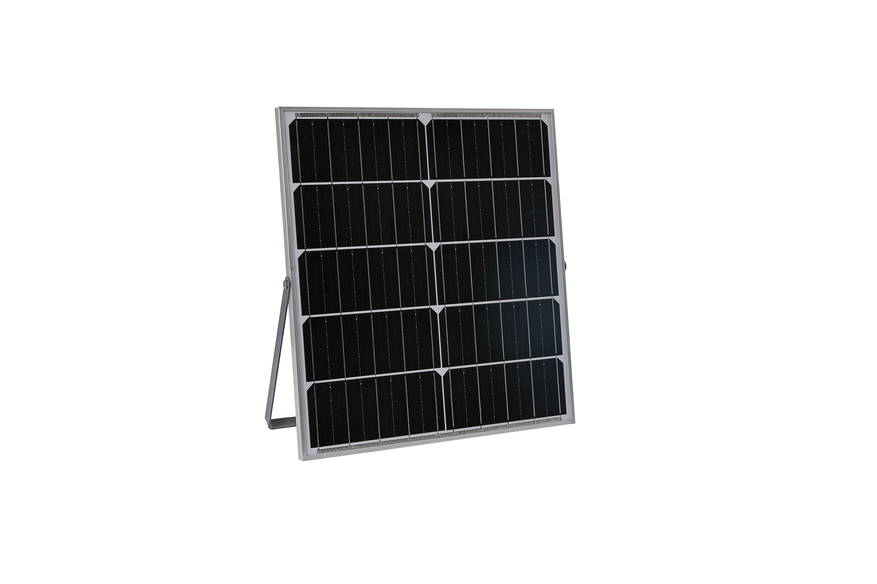
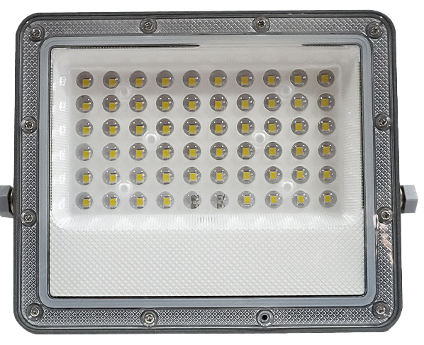
F – LG601
17
Solar projection light
Simple and fashionable design with higher luminous flux split solar projector

Slide 16
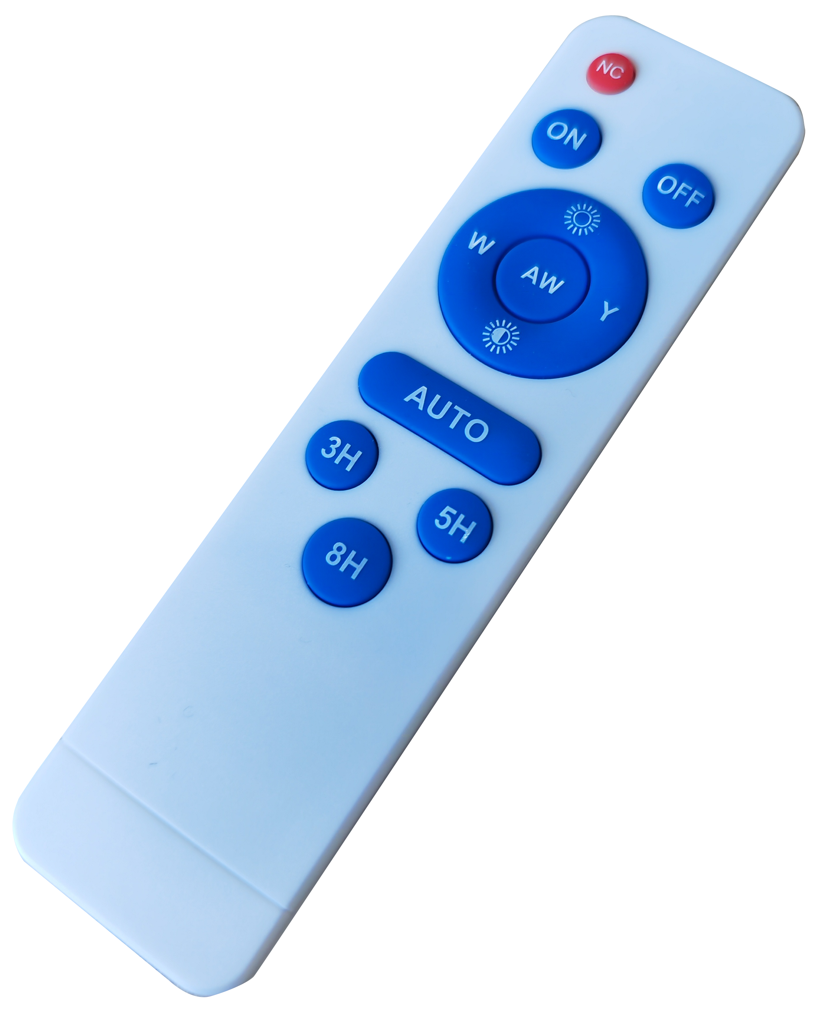
F – LG601
Characteristics
Model
Power
Luminous flux
Battery
Solar panel
F-LG601
60W /100W / 200W / 300W
600lm / 900lm / 1300lm / 1800lm
3.2V- 5Ah / 5Ah / 10Ah / 15Ah
5V- 5W / 8W / 10W / 15W
Polycrystalline silicon
IP level
Material
Functional feature
charging time
Working time
Color
IP65
ABS+PC
Light control, radar, remote control discharge time of 12 hours can work continuously for 2-3 rainy days
6-8h
>12h

